Slide 1
Ghidra-LLM: Large Language Models for Static Reverse Engineering
Week 15 Update
Project 9: Bisesh, Mack, Maximilan, Craig, Justin

Slide 2
Review - Project Goal
In this project, our team will create large language model support for NSA’s new reverse engineering tool, Ghidra.
Reverse engineering is inherently a lossy process. Valuable context and data is often lost or obscured. Our goal is to use machine learning to bridge this gap.

Slide 3
Review – Project Process
Multi-step project that consists of numerous phases
Phase 1: Research & Red Teaming current LLM application (Current)
Phase 2: Improving current models (Late Fall – Early Spring)
Phase 3: Further refinement & integrating our new model into Ghidra (Spring)

Slide 4
Review – Phase 1
We are taking advantage of a current existing open-source large language model "LLM4Decompile".
This LLM already has the ability to decompile binary/assembly to C (Best version ~65% accurate)
Our current goal is to refine this LLM to become more accurate.
How do we accomplish this?

Slide 5
Team Objectives
Our team has the latest LLM4Decompile model running on our development environment
Hosting this model on ubuntu desktop provided by GMU, with code repository (github) https://github.com/SPIRE-GMU/SPIRE_GLLeN/tree/dev
With the model running, we can begin to test, improve, and refine it.
We have split into 2 teams to achieve these objectives
RAG Team – This team oversees building a RAG Pipeline that we will combine with LLM4Decompile to improve accuracy
Red Team – This team oversees evaluating the current LLM4Decompile model and determining where it falls short.

Slide 6
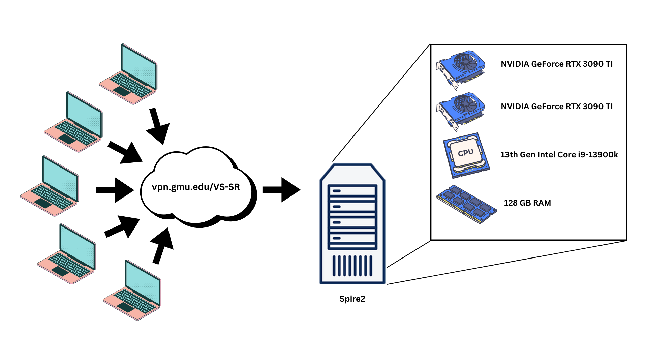
Lab Environment

Slide 7
Red Team (Mack, Max, Bisesh) Objectives – Last 3 weeks
Scaled code to function with higher levels of optimization
Improved report to include higher levels of optiization
Began to create the code to test the now functional rag pipeline but at scale
Testing a second layer of LLM for decompiling

Slide 8
Red Team (Mack, Max, Bisesh) Objectives – Next 2 weeks
Scale
Test the rag pipeline at scale
Diversify
Work on testing other models with a rag pipeline and test those at scale
Report
Create a report on the results based on the many models
Test and write out LLM scripts on a small batch of files and measure efficacy
Add

Slide 9
RAG Team (Craig, Justin) Objectives – Last 3 Weeks
Holiday Break
Optimized and Scaled vector RAG pipeline to quantify results
Adjusted many code aspects to work with high scaled data
Added multiple models support
Began research into taking the assembly (.s) files and converting to CFG
Tested Ghidra headless analysis
Tested Radare2
Found that this is not going to work for our needs at this time. Pinning it and trying another route.

Slide 10
RAG Team (Craig, Justin) Objectives – Next 2 Weeks
Run large scale tests to quantify RAG pipeline performance
Pivoting from the previous attempt of using assembly file to CFG
Instead we are going to do research into doing multiple passes and using the resulting .c file and then creating the CFG from that file.

Slide 11
Transition Period (Spring – Fall semesters)
Before End of Semester
Initial metrics to quantify our hypothesis
Optimizing and Finetuning
Winter Break
Finalize RAG pipeline integration with all data types
Beginning of Spring
Begin large scale metrics collection
Begin writing report for ACM CCS 2025

Slide 12
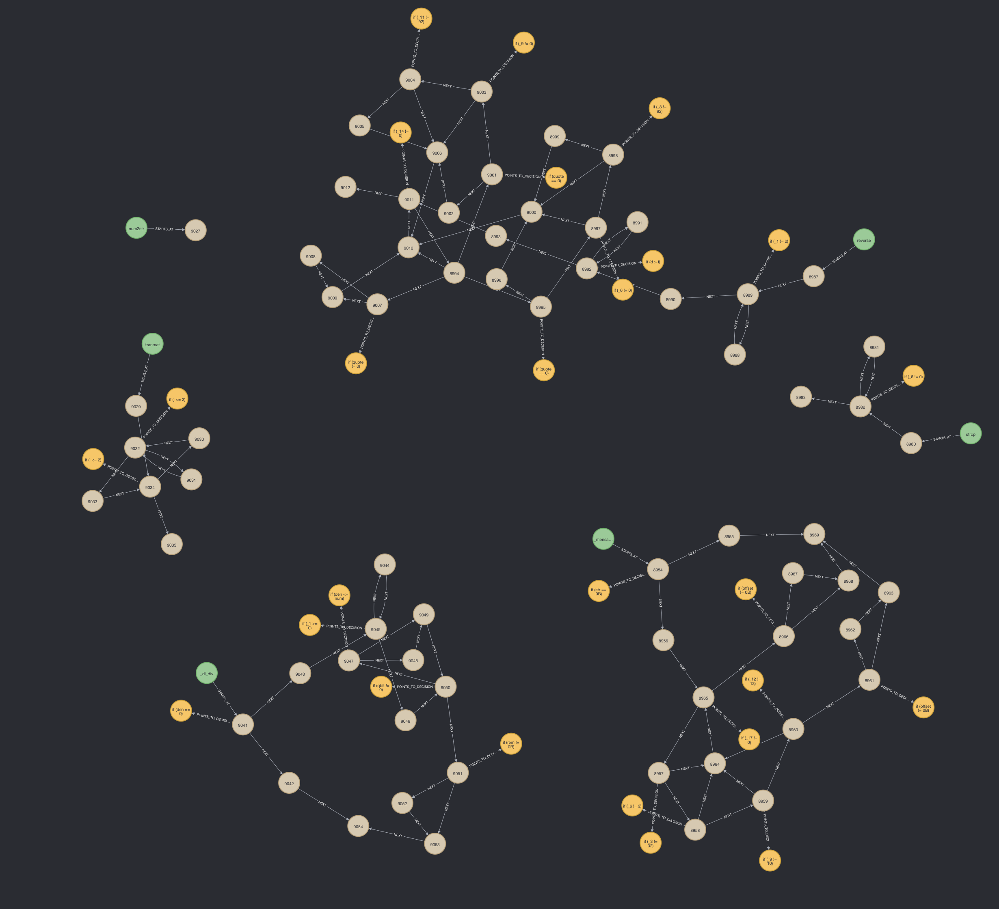
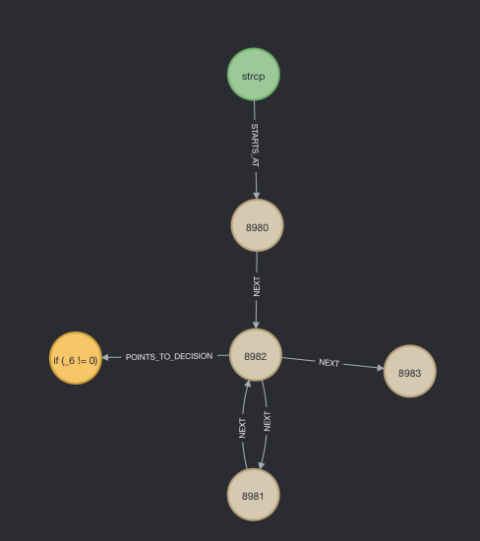
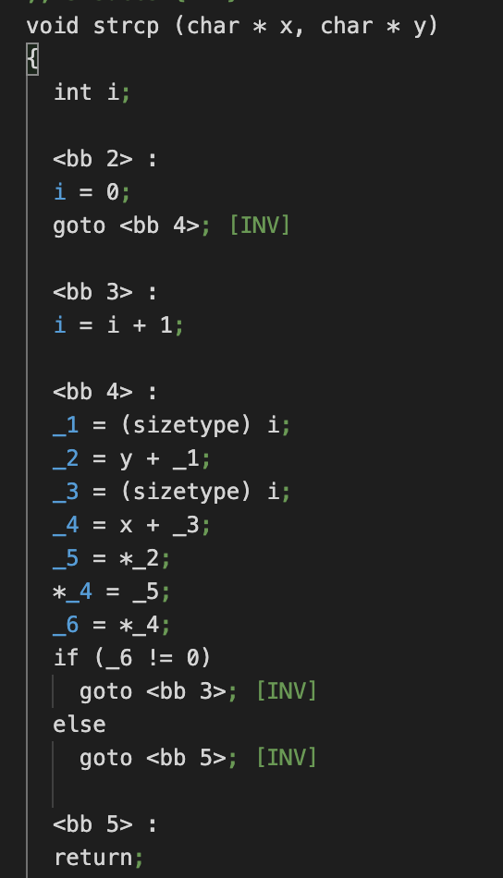
CFG Map

Slide 13
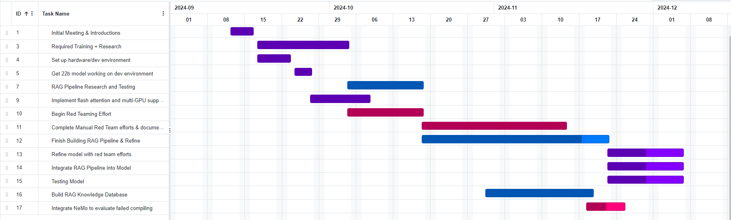
Gantt Chart – Phase 1

